Slide 1
Saskatchewan
November 15
2020
By Kip Taylor

Slide 2
History of Saskatchewan
. Saskatchewan is known for its deep economic ties to oil and its lands of rivers and the infamous 100,000 lakes. The climate is very variant, due to its placement in the middle latitudes. It is known for its severe winters dropping to -49 degrees Fahrenheit and in the summers getting as hot as 113 degrees Fahrenheit in the summers. Due to this the best time to visit would be mid spring to avoid most of the nasty weather.

Slide 3
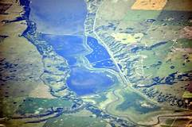
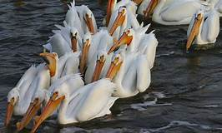
Destination one
Last Mountain Lake
North Americas oldest bird sanctuary. It was formed by glaciers and founded in 1887. This sanctuary supports hundreds of thousands of birds and the 36 known endangered species in Canada alone. Most trails are fully open during the mid-spring and close near winter. This area has amazing fishing, hunting, trails, and bird sights for almost any type of person

Slide 4
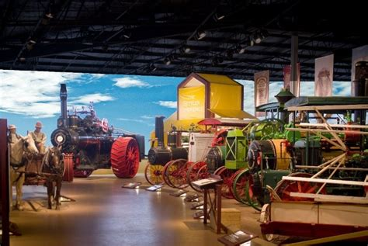
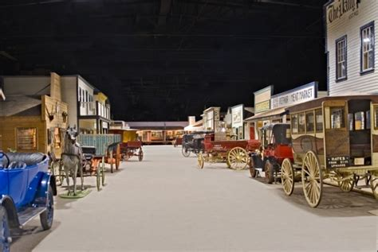
Destination two
4 Museums to visit that are bent on preserving the social and economic development of the province. Each branch focuses on different themes: Transportation, agriculture, economy, and finally the people. Any time of year is the best to visit these locations. The reason its four and not just one is because each one focuses on a part of society , economic , transportation , agriculture and finally the people.
Source : https://wdm.ca/
Western Development Museum crawl

Slide 5

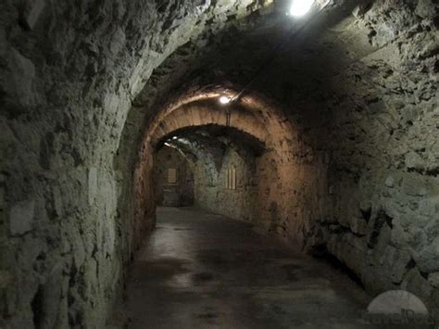
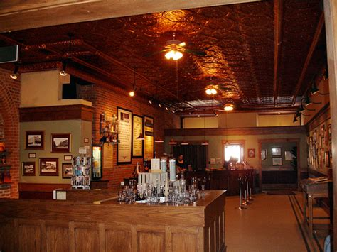
Destination 3
The Tunnels of Moose Jaw
Located in Moose Jaw Saskatchewan, this is a year-round attraction where guests are entertained by a theatrical presentation of Canadian history. You can relieve Al Capones bootlegging in the Chicago Connection and see firsthand the hardships the early Chinese immigrants were in the passage to fortune area. I think this spot is really something amazing, seeing real history and political significance in a play and many fun areas to explore. The two tours are named, Fortune Passage and Chicago Connection.
Source: https://www.tunnelsofmoosejaw.com

Slide 6
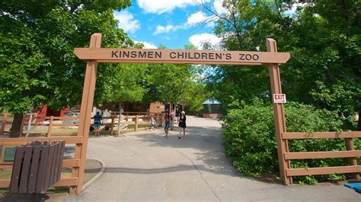
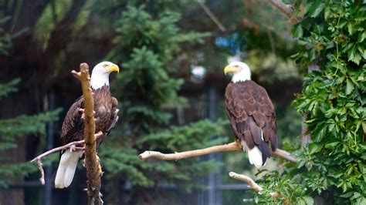
Destination 4
Saskatoon Forestry Farm Park & Zoo
Located in Saskatoon, this place houses historical breeds of animals in a safe enclosure for all to see, along with a spectacular Christmas light festival hosted during December. The best time to go would be during the mid-December for the festival shows and to show your family and kids all the different breeds that are a part of this region. This is more of a great lighthearted adventure into the suburban wilderness all within the comfort of modern society. Though do prepare for long walks and great sights

